Slide 1

The Servlet Model
HTTP Methods
Form Parameters Requests Responses
Servlet Life Cycle

Slide 2
Review
• How to connect DB using JDBC API
– Required
• RDBMS: SQL Server
• Driver Connection: sqljdbc4.jar
– Steps
• Load Driver
– using Class.forName method
– Driver string: com.microsoft.sqlserver.jdbc.SQLServerDriver
– Exception: ClassNotFoundException
• Create connection String
– protocol:server://ip:port;databaseName=DB[;instanceName=Instance]
• Open connection
– Connection con = DriverManager.getConnection(url, “user", “pass");
– Exception: SQLException

Slide 3
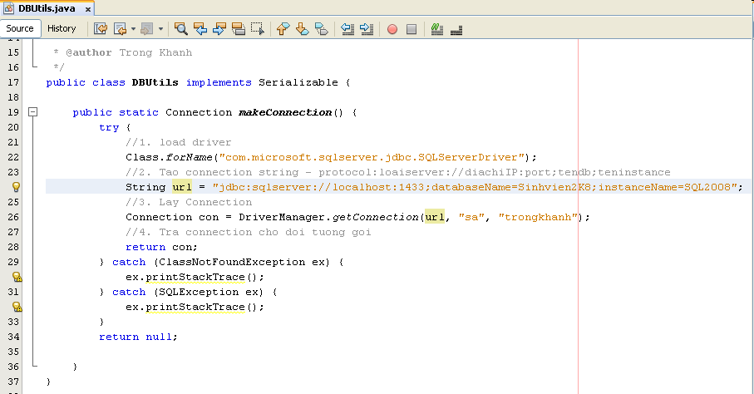
Review
• How to connect DB using JDBC API
– Implementation

Slide 4
Objectives
• How to build the simple web site combining html and servlet?
– Http Protocol and Methods
– What is Servlet?
– Parameters vs. Variables
– Servlet Life Cycle
– Break down structure component in building web application

Slide 5
Objectives
Topic 1 – Login
Servlet
Topic 2 – Search
Break Down
Topic 3 – CUD, Shopping Cart
Session
Web
Topic 4 – Login
Security
Advanced
Java - PBL
Enterprise
Topic 5 – CRUD
MVC 2 - Scripting
Topic 6 – Login
MVC 1 - Action
Topic 7 – CRUD
MVC 2 Complete - JSTL - Taglib

Slide 6
Build The Simple Web
Requirements
• Building
the
web
application
can
do
some
following functions as
– The user must be authenticated before they want to
use this web site using the DB
– If the user is invalid, the message “Invalid username and password” is presented, then the link “Click here to try again” is shown that redirect the user to the login page
– Otherwise, the search page is redirected.
– The GUI of web application is present as following

Slide 7
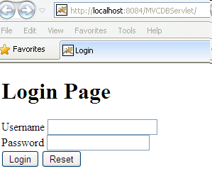
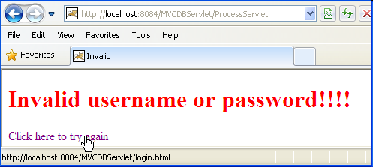
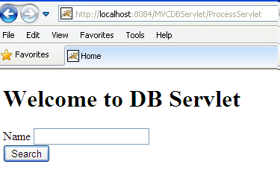
Build The Simple Web
Expectation

Slide 8
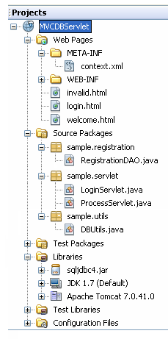
Build
The Simple
Expectation
Web
HTML
Servlet
DB Connection Lib
JDBC Driver

Slide 9
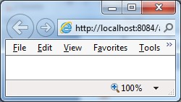
Build The Simple Web
Interactive Server
Model
2. Send request
Web/App
Server
Servlet
1. Click Login
3. Check Login
5. Response the
result page
DAO
4. Query DB
6. Browser
displays Welcome page/ invalid page
DB
Client
Server

Slide 10
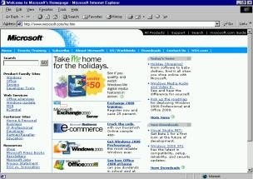
Build
The Simple
Abstraction
Web
Web Server
Container
4. Render/Send
V
1. Send request
C
2. Call
3. Query
5. Response
DAO
DB
6. Display

Slide 11
Build The Simple Web
How to Create Web Application Project
• Requirement tools: NetBeans IDE 7.4/8.0.2/8.1
• Create a new Web application project
– Using Tomcat Server
– JavaEE 5
– Uncheck Deploy on Save

Slide 12
HTML Introduction
What is HTML?
HTML is a presentation language for describing
web pages.
– HTML stands for Hyper Text Markup Language
– HTML is not a programming language, it is a
markup language
– A markup language is a set of markup tags
– HTML uses markup tags to describe web pages
HTML Documents = Web Pages
– HTML documents describe web pages
– HTML documents contain HTML tags and plain text
– HTML documents are also called web pages
•
•

Slide 13
HTML Introduction
HTML Tags
• HTML markup tags are usually called HTML tags
– HTML tags are keywords surrounded by angle brackets, that begin “<” and finish with “>”, like <html>
– HTML tags normally come in pairs like <b> and </b>
• The first tag in a pair is the start tag, the second tag is the end tag
• Start and end tags are also called opening tags and closing tags.
• Web Browser
– The purpose of a web browser (like Internet Explorer, or Firefox, etc) is to read HTML documents and display them as web pages.
– The browser does not display the HTML tags, but uses the tags to
interpret the content of the page

Slide 14
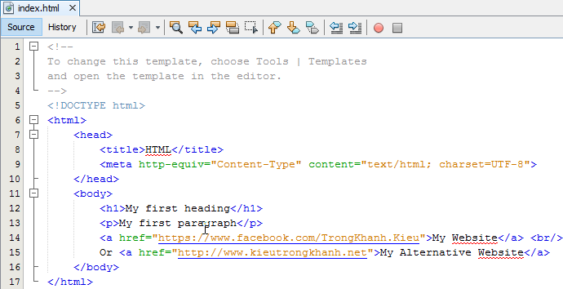
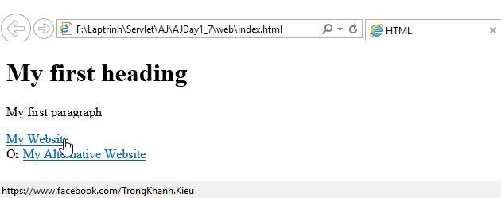
HTML Introduction
Example

Slide 15
Form Parameters
HTML Form
• A form is defined on a web page starting with the opening tag <form> and ending with closing tag </form>
• Syntax: <form action=“target” [method=“HTTP method”]>
– action attribute presents value that contains some target resource in the web application (e.g. Servlet or JSP)
– method attribute denotes the HTTP method to execute. The
default is to execute HTTP GET when the form is submitted
– Notes: the action parameter obeys the rules
• action=“targetServlet”: the browser will assume that targetServlet resides in the same place the default page as index.jsp or index.html
• action=“/targetServlet”: the browser will asume the the path at the root location for specified host (http://host:port).
– Ex: http://localhost:8086/targetServlet
• action=“target?queryString”:the request send the data in queryString to the URL

Slide 16
Form Parameters
Input Tag
• Is used to input data
• Syntax: <input type=“…” [value=“…” name=“…”] />
– type attribute
•
Dedicates to holding a single line of text (text).
– The size attribute specifies the width of text field in characters
– The maxlength attribute controls the maximum number of characters that a user can type into the text field
A browser should mask the character typed in by the user (password) Being a hidden field – is invisible (hidden)
Put one or more small boxes that can be clicked to tick or check the
corresponding value denote (checkbox)
– checked=“checked” sets up the checkbox as already selected
The choice made is mutual exclusive (radio)
– The name attribute is crucial to tying together a group of radio buttons
Send the form data to the URL designated by the action attribute (submit) A request to the client browser to reset all the values within the form (reset) Defining the “custom button” which is connected to some soft of script
(button)
•
•
•
•
•
•
•
– name attribute supplies the parameter name
– value attribute supplies the parameter value

Slide 17
Form Parameters
Select & Text Area Tag
• HTML Forms – select tag
– Sets up a list of values to choose (combo box or pop-up menu, or list box)
– Syntax: <select name=“…” [size=“…” multiple] >
<option value=“…” [selected]>…</option>
…
</select>
• option tag
– The user-visible text goes between opening and closing option tag
– The value attribute passes the value in the parameter
• multiple attribute presents the control that can choose more than one
• HTML Forms – textarea tag
– Presents multiple line of text
– Syntax: <textarea name=“…” rows=“…” cols=“…”>
…
</textarea>
• The text value put in opening and closing tag is passed as the parameter value to server
• rows present the number of visible lines
• cols present the number of characters to displayed across the width of the area

Slide 18
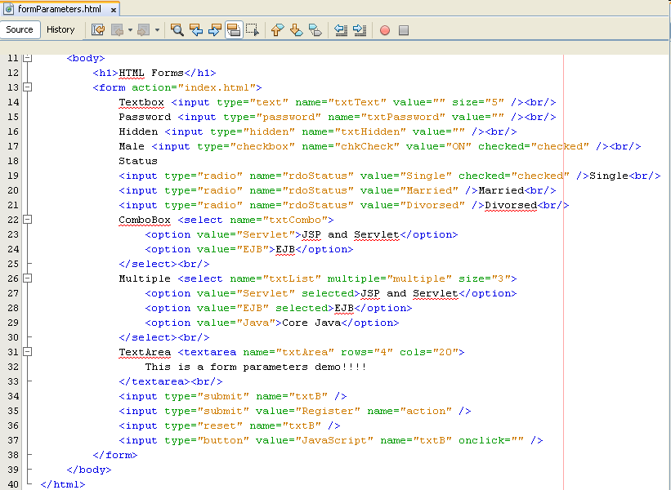
Form Parameters
Examples

Slide 19
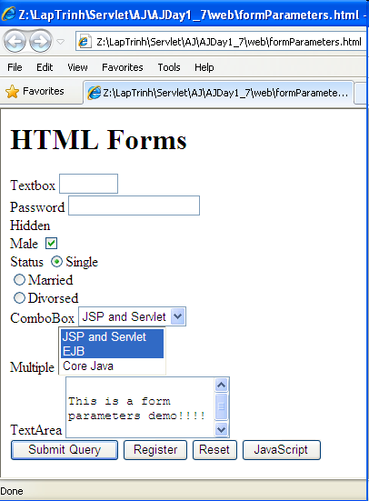
Form Parameters
Examples

Slide 20
Build The Simple Web
Views

Slide 21
Build The Simple Web
Interactive Server
Model
2. Send request
Web/App
Server
Servlet
1. Click Login
5. Response the
result page
3. Check Login
DAO
4. Query DB
6. Browser
displays Welcome page/ invalid page
Client
DB
Server

Slide 22

HTTP Protocols
Overview
1. Convert http://microsoft.com/ to 192.168.54.3:80
Connect
2. Send a request to Web Server (index.html)
4. The result is responsed to Browser
http://microsoft.com/index.html
5. Web Browser views
192.168.54.3:80
3.
Web
Server
the
result
which
markup
processes
a
request
DB, call
contains
language
a
(connecting
calculating, service …)
• Request
• Stateless
• Port 80 is default
– Response
pairs

Slide 23
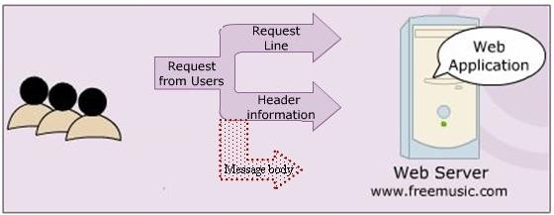
HTTP Protocols
HTTP Requests
A carriage return/ line feed

Slide 24
HTTP Protocols
HTTP Requests
•The HTTP method
•A pointer to the resource requested, in the form of a URI
•The version of HTTP protocol
•Ex: GET /index.html HTTP/1.1
A carriage return/ line feed

Slide 25
HTTP Protocols
HTTP Requests
A carriage return/ line feed
•Return the User-Agent (the browser) along with the Accept header in the form name:value (provides information on what media types the client can accept)
•Ex: User-Agent: Mozilla/4.0 (compatible: MSIE 4.0 : Windows 95) Accept : image/gif, image/jpeg, text/*, */*

Slide 26
HTTP Protocols
HTTP Requests
A carriage return/ line feed
•Contain pretty much any thing (a set of parameters and values, an
image file intending to upload)

Slide 27
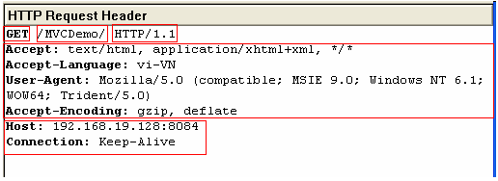
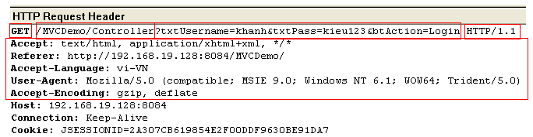
HTTP Protocols
HTTP Requests – Example

Slide 28
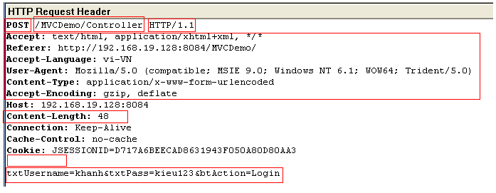
HTTP Protocols
HTTP Requests – Example

Slide 29
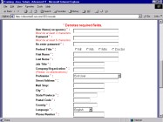
The Servlet Model
Request Objects
1. Input and
click button/link
3. Send request
4. Dispatch to Servlet/Web Container
Containter
5. Container
^{Request} create Req
6. Send
Response
Object
Resources
8. Set Val
Web/App
Server
2. Generate the
Request msg
Request
Object
create Req Obj
10. Send response
9. Create
Response Msg
OS
7.retrieve
data (if any)
DB
Client
Server

Slide 30
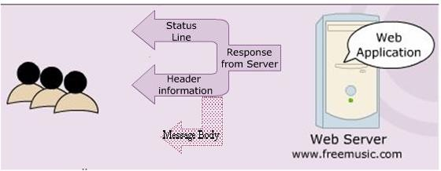
HTTP Protocols
HTTP Responses
Blank line

Slide 31
HTTP Protocols
HTTP Responses
• Indicates status of request process (HTTP version, response code, status)
• Ex: HTTP/1.1 200 OK
Blank line
•Server. Ex: Server: JavaWebServer
•Last modified date.
• Ex: Last-modified: Tuesday, 24-Mar-09 8:30:34 GMT
•Content length. Ex: Content-length: 100
•Content type. Ex: Content-type: text/plain

Slide 32
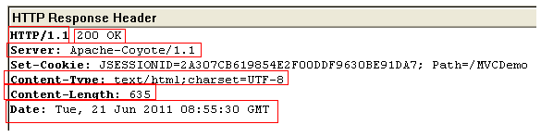
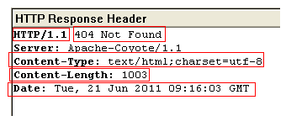
HTTP Protocols
HTTP Responses – Example

Slide 33
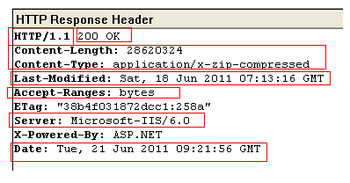
HTTP Protocols
HTTP Responses – Example

Slide 34
HTTP Protocols
Some
commonly Status codes
Code
Associated Message
Meaning
101
Switching Protocols
- Server will comply with Upgrade header and
change to different protocol. (New in HTTP 1.1)
200
OK
- Everything is fine; document follow
-
Default for servlets
201
Created
- Server created a document
-
The Location header indicates
its URL
203
Non-Authoritative
Information
- Document is being returned normally, but some of
document copy is being used.
the response headers might
be incorrect
since
a
204
No Content
- Browser should keep displaying previous document
301
MovedPermanently
- Document is moved to a separate location as mentioned in the URL.
find the document
-
The page is redirected to the mentioned URL, to
302
Found
- Temporary replacement of file from one location to
the other as specified

Slide 35
HTTP Protocols
Some
commonly
Status
codes
Status code
Associated Message
Meaning
400
Bad Request
- The request placed is syntactically incorrect
401
Unauthorized
- Authorization not given to access a password
protected page
403
Permission denied
- Authentication but authorization not given to
access protected resource
404
Not Found
- Resource not found in the specified address
408
Request Timeout
- Time taken by client is very long to send the
request (only available in
HTTP 1.1)
500
Internal Server Error
- Server is unable to locate the requested file. The servlet has been deleted or crashed or had been moved to a new location with out informing
503
- Indicates that the HTTP server is temporarily
overloaded, and unable to handle the request
…
…
-…

Slide 36
HTTP Protocols
• GET
HTTP Methods – Basic
– Is the method commonly used to request a resource/ get
information (access static resource such as HTML doc and
images or retrieve dynamic information such as query parameters)
from server
– The restricted length of query string, that is introduced by the
question mark “?”
– Is trigger by
• Typing into the address line of the browser and pressing GO
• Clicking on a link in a web page
• Pressing the submit button in an HTML form with GET method
• POST
– Sends data of unlimited length to the web server.
– Is the method commonly used for passing user input/ sending
information to the server (access dynamic resources and enable
secure data in HTTP request because the request parameters are
passed in the body of request)
– No limit and cannot be booked mark or emailed

Slide 37
HTTP Protocols
HTTP Methods – Extends
• HEAD
– Returns the headers identified by the request URL.
– Is identical to the GET method but it doesn’t return a message body
– Is an economical way of checking that a resource is valid and accessible
• OPTIONS
– Returns the HTTP methods the server supports.
• PUT
– Requests the server to store the data enclosed in the HTTP message body at a
location provided in the request URL.
• DELETE
– Requests the server to delete the resource identified by the request URL.
• TRACE
– Is used for debugging and testing the request sent to the server. It is useful
when the request sent to the server reaches through the proxies.
• Idempotency and Safety
– GET, TRACE, OPTIONS, and HEAD

Slide 38
Build The Simple Web
Interactive Server
Model
2. Send request
Web/App
Server
Servlet
1. Click Login
5. Response the
result page
3. Check Login
DAO
4. Query DB
6. Browser
displays Welcome page/ invalid page
DB
Client
Server

Slide 39
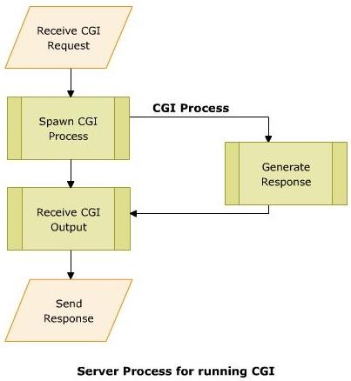
The Servlet Model
Common Gateway
A small program (*.exe) is written
in languages such as C/C++, Perl,
... for the gateway programs.
Used in complex applications, such as Web pages
A set of standards followed to interface applications form client side to a Web Server
Enables the Web server to send information to other files and Web browsers
Helps to process the inputs to the form on the Web page
Enables to obtain information and use it on the server machine (server side)
When the Browser sends request to server, CGI instantaties to receive and process.
Interface
(CGI)
•
•
•
•
•
•
•

Slide 40
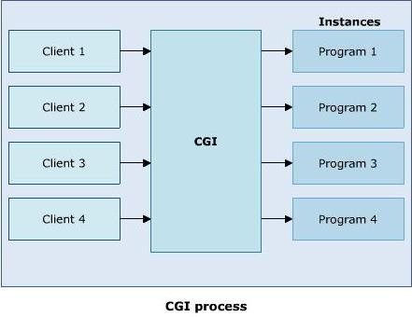
The Servlet Model
Common Gateway Interface (CGI)
• Disadvantages
– Reduced efficiency

Slide 41
The Servlet Model
Common Gateway
• Disadvantages
– Reduced efficiency
– Reloading Perl interpreter
• The widely accepted platform Each time the server receives needs to be reloaded.
Interface
(CGI)
for writing CGI script is Perl.
are quest, the Perl interpreter
– Interactive: not suitable for graphical or highly
interactive programs
– Time consuming and more memory consumed
– Debugging: error detection is difficult
– Not support Session

Slide 42
The Servlet Model
Servlets
•
Are Java classes that dynamically process HTTP requests and construct responses
Are Java codes that are used to add dynamic content to Web server.
There is only a single instance of Servlet created on the Web server.
To service multiple clients’ request, the Web server creates multiple threads for the same Servlet instance (Overcome CGI’s consumed more memory)
Gets auto refreshed on receiving a request each time
•
•
•
•
•
•
A Servlet’s initializing code is used only for initializing in the
Merits
– Enhanced efficiency (initializing only once, auto refresh)
– Ease to use (using Java combining HTML)
– Powerful (using Java)
– Portable
– Safe and cheap
Demerits
1st
time
•
– Low-level HTML documentation (Static well-formed-ness is not maintained)
– Unclear-session management (flow of control within the codes is very unclear)

Slide 43
The
Servlet Model
Servlets
• How to server
detecting
the servlets
(difference
from
Java
class),
then,
initializing in the
1st
time?
– Web deployment descriptors (web.xml)

Slide 44
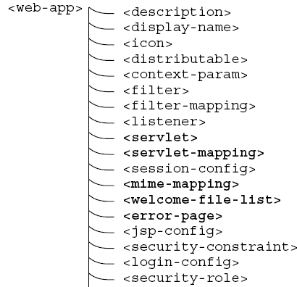
The Servlet Model
The Deployment Descriptor
•
The
Web
Deployment
Descriptor file
describes
all
of
Web
components
It is an XML file. Given that the name is web.xml.
•

Slide 45
The Servlet Model
The Deployment Descriptor –
<?xml version="1.0" encoding="UTF-8"?>
<web-app version="2.5" xmlns="http://java.sun.com/xml/ns/javaee" xmlns:xsi="http://www.w3.org/2001/XMLSchema-instance" xsi:schemaLocation="http://java.sun.com/xml/ns/javaee http://java.sun.com/xml/ns/javaee/web-app_2_5.xsd">
web.xml
<servlet>
Servlets Declaration is same as package.classname servlet_name;
<servlet-name>servlet name</servlet-name>
<servlet-class>package.classname</servlet-class>
</servlet>
<servlet-mapping>
Define the access path to the servlet;
<servlet-name>servlet name</servlet-name>
<url-pattern>/context Path/root</url-pattern>
</servlet-mapping>
<session-config>
<session-timeout>30</session-timeout>
</session-config>
<welcome-file-list>
<welcome-file>default page to show</welcome-file>
</welcome-file-list></web-app>

Slide 46
The Servlet Model
The Deployment Descriptor –
<?xml version="1.0" encoding="UTF-8"?>
<web-app version="2.5" xmlns="http://java.sun.com/xml/ns/javaee"
xmlns:xsi="http://www.w3.org/2001/XMLSchema-instance"
xsi:schemaLocation="http://java.sun.com/xml/ns/javaee
http://java.sun.com/xml/ns/javaee/web-app_2_5.xsd">
<servlet>
<servlet-name>HelloServlet</servlet-name>
<servlet-class>servlet.sample.HelloServlet</servlet-class>
</servlet>
<servlet-mapping>
<servlet-name>HelloServlet</servlet-name>
<url-pattern>/HelloServlet</url-pattern>
</servlet-mapping>
<session-config>
<session-timeout>30</session-timeout>
</session-config>
<welcome-file-list>
<welcome-file>HelloServlet</welcome-file>
</welcome-file-list></web-app>
Example

Slide 47
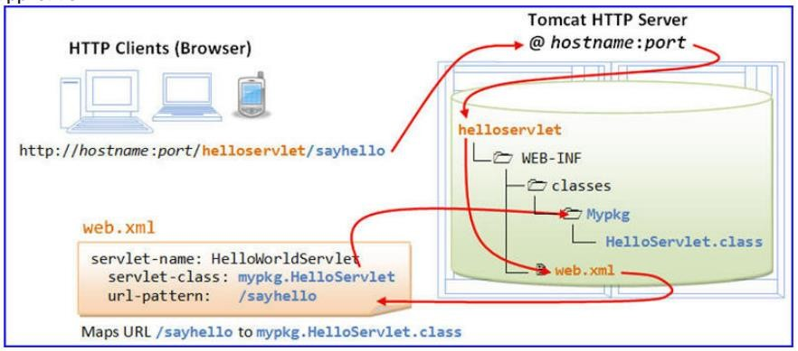
The Servlet Model
Deployment Descriptor – Example
The
2. Send Request
3. Dispatch to Application
1. User types url
4. Find web.xml
6. Access the servlet instance
5. Look up the servlet class from mapping to
find the servlet instance web.xml

Slide 48
The Servlet Model
Servlets
Web
Server
2. Choose Servlet I
ServletContainer
Servlets
1. Send Request
Internet HTTP Protocol
Browser
Client
nstance
4.
Response
3. Query (if any)
Database

Slide 49
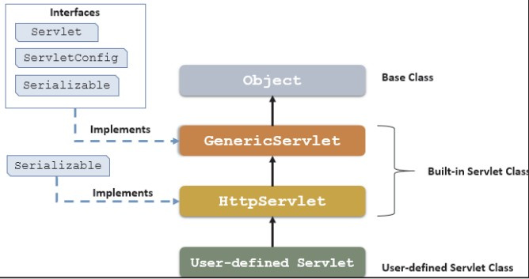
The Servlet Model
Architecture of the Servlet packages
The javax.servlet package provides interfaces and classes for writing
servlets
•
•
The important interface is javax.servlet.Servlet
•
When a servlet accepts a call from a client, it receives two objects:
•
ServletRequest, which encapsulates the communication from the client to the
server.
ServletResponse, which encapsulates the communication from the servlet to the client.
•

Slide 50
The Servlet Model
GenericServlet class
• Defines a servlet that is not protocol dependent
• Implements
the
Servlet,
the
ServletConfig,
and
the
java.io.Serializable interfaces
• Retrieves the configuration information by implementing the
ServletObject
• Some methods
Methods
Descriptions
init
- public void init() throws ServletException
- Initializes the servlet
Servlet
Life service Cycle
defined
- public abstract void service(ServletRequest req, ServletResponse res) throws ServletException,
- Called by the container to respond to a servlet request
IOException
in Generic
destroy
- public void destroy(): cleaning the servlet

Slide 51
The Servlet Model
The Servlet
Life Cycle
5. first to n^{th} req
meet request
Uninstantiated
1. begin to
deploy
Instantiation
2. deploying
Initialization
Meet multi request
success
init()
success
service()
4. first req
failure
3. deployed
Detroy received request and using
thread
failure
Unload
Unavailable
destroy
6. undeploy,
server is crashed, unload servlet
destroy()
The life cycle is defined by
• init() – called only one by the server in the first request
• service() – process the client’s request, dispatch to doXXX() methods
• destroy() – called after all requests have been processed or a server- specific number of seconds have passed

Slide 52
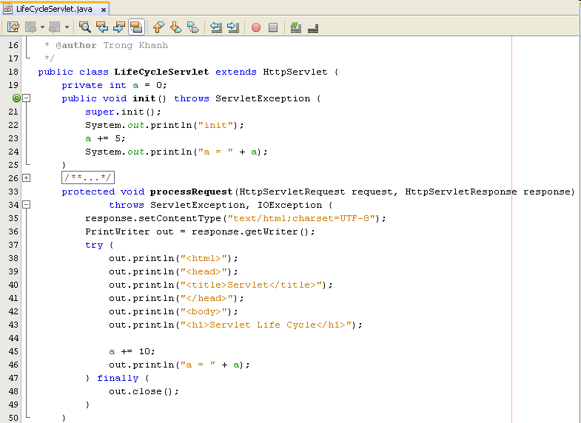
The Servlet Model
The Servlet Life Cycle – Example

Slide 53
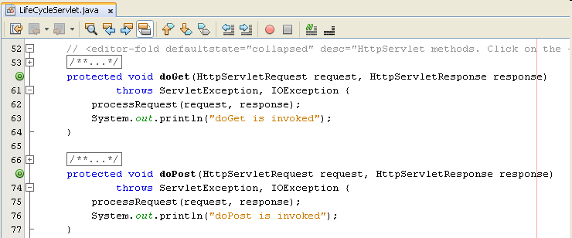
The Servlet Model
The Servlet Life Cycle – Example

Slide 54
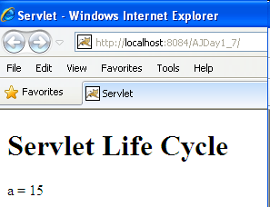
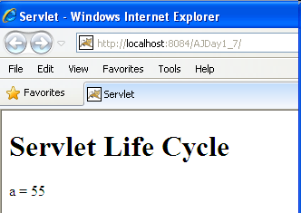
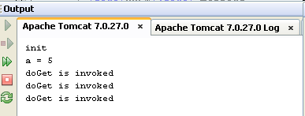
The Servlet Model
The Servlet Life Cycle – Example

Slide 55
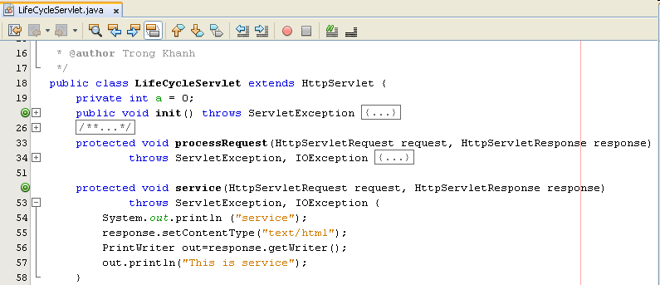
The Servlet Model
The Servlet Life Cycle – Example

Slide 56
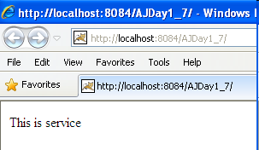

The Servlet Model
The Servlet Life Cycle – Example

Slide 57
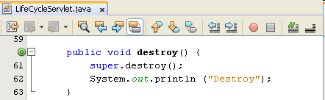
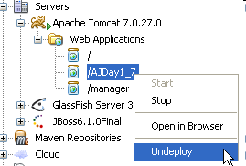
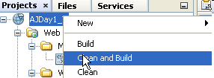

The Servlet Model
The Servlet Life Cycle
• Addition the destroy method (comment service
– Example
method)
• Execute project again, then undeploy or clean and Build the
current project on Tomcat Server

Slide 58
Build The Simple Web
Interactive Server
Model
2. Send request
Servlet
Web/App
Server
1. Click Login
5. Response the
result page
3. Check Login
DAO
4. Query DB
DB
6. Browser
displays Welcome page/ invalid page
Client
Server

Slide 59
Summary
• How to build the simple web site using html and servlet?
– Http Protocol and Methods
– What is Servlet?
– Parameters vs. Variables
– Servlet Life Cycle
– Break down structure component in building web application
Q&A

Slide 60
Summary
Web Server
Container
4. Render/Send
V
1. Send request
C
2. Call
3. Query
5. Response
DAO
DB
6. Display
Q&A

Slide 61
Exercises
• Do it again all of demos
• Using servlet to write the programs as the following
requirement
– Present the Login form (naming LoginServlet) with title Login,
header
h1
–
Login, 02
textbox
with
naming
txtUser
and
txtPass, and the Login button
• Rewrite above Login application combining with DB
– Writing the ColorServlet that presents “Welcome to Servlet
course” with yellow in background and red in foreground
– Writing the ProductServlet includes a form with a combo box containing Servlet & JSP, Struts & JSF, EJB, XMJ, Java Web Services, and the button with value Add to Cart

Slide 62
Next Lecture
• How to deploy the Web Application to Web
Server?
– Web applications Structure
– Request Parameters vs. Context Parameters vs.
Config/Servlet Parameters
– Application Segments vs. Scope
• How to transfer from resources to others
with/without data/objects?
– Attributes vs. Parameters vs. Variables
– Redirect vs. RequestDispatcher
– RequestDispatcher vs. Filter

Slide 63
Next
Lecture
Topic 1 – Login
Servlet
Topic 2 – Search
Break Down
Topic 3 – CUD, Shopping Cart
Session
Web
Topic 4 – Login
Security
Advanced
Java - PBL
Enterprise
Topic 5 – CRUD
MVC 2 - Scripting
Topic 6 – Login
MVC 1 - Action
Topic 7 – CRUD
MVC 2 Complete - JSTL - Taglib

Slide 64

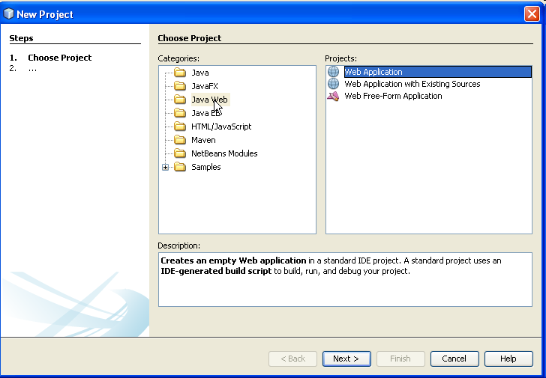
Appendix – Build
The Simple Web
How
to
Create
Web
Application
Project
• Click Java Web
categories
• Click the “Web Application” Projects
• Click Next button

Slide 65
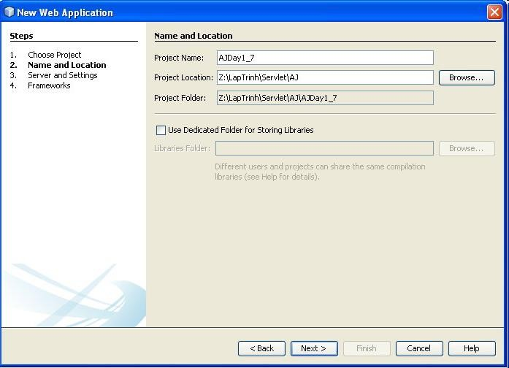
Appendix – Build
The Simple Web
How to
Create
Web
Application Project
Fill your project name
Browser your location
where store the project
• Click Next button

Slide 66
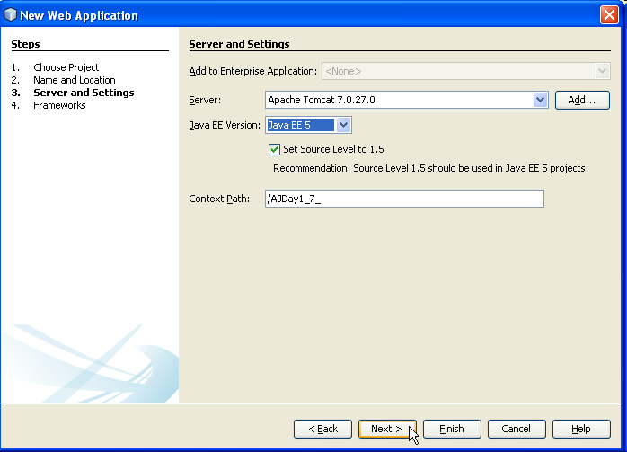
Appendix – Build
The Simple Web
How
to
Create
Web
Application Project
Choose deployed server
Choose Java EE 5/
J2EE 1.4
Modify the context path
(if necessary). Defaults, it is named same as Project Name
•
Click Finish button

Slide 67
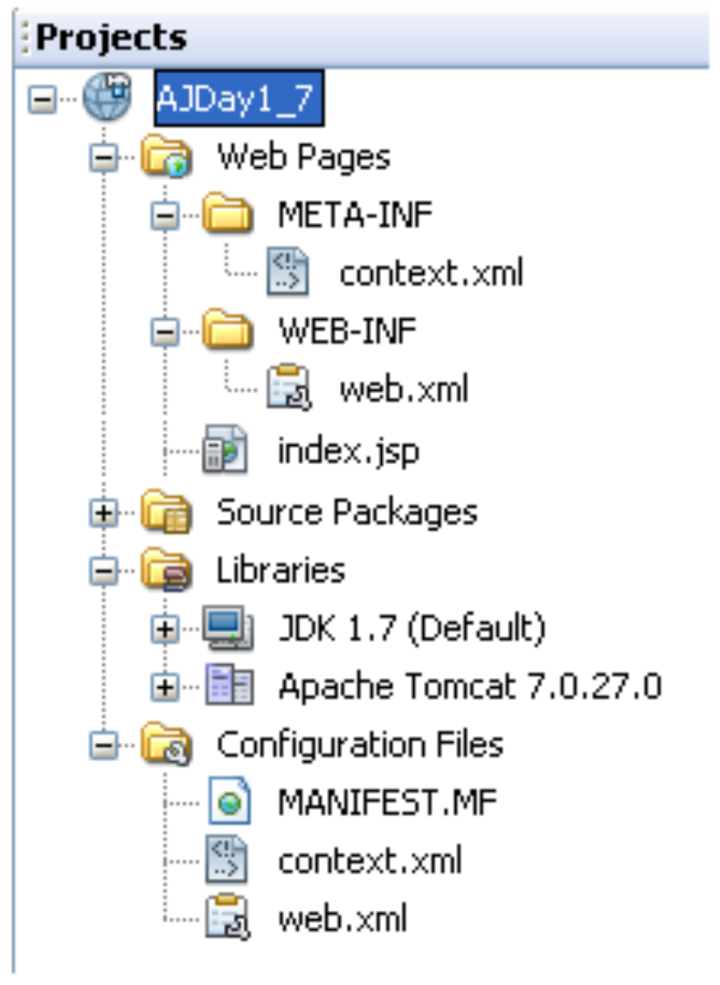
Appendix – Build The Simple Web
How
to
Create
Web Application
Project name
Project
Web Directory
Web deployment descriptor
Source code directory, containing java class. When
project is built, package in classes directory
Support library directory, containing jar file.
When project is built, package in lib directory
Configuration directory related define for
Web App

Slide 68
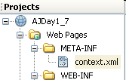

Appendix – Web Applications
Add the META-INF/context.xml to project
• optional – if it does not exist
–
–
–
–
–
–
–
Right click the Web Pages, choose New, then choose Other
In New File Dialog, choose Other, then choose Folder, click Next In New Folder Dialog, type the META-INF into Folder Name Click Finish
Right click the META-INF, choose New, then choose Other
In New File Dialog, choose XML, then choose XML Document, click Next
In New XML Document Dialog, type context into File Name, click Next,
then click Finish
Type the content of content.xml file as (Notes: must type “/” in front of context)
–

Slide 69
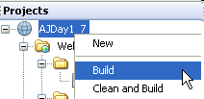
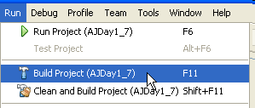

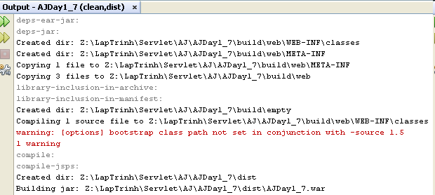
Appendix
Build Application

Slide 70
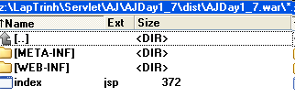

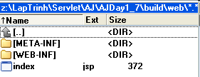
Appendix
Build
Application
• Package War file with command prompt
– jar –cvf fileName.war directoryOrFile
– Ex: jar –cvf AJDay1_7.war *.jsp WEB-INF/*

Slide 71
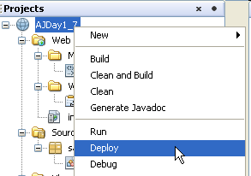
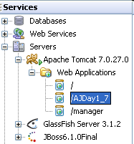
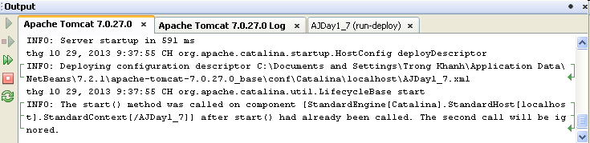
Appendix
Deploy Application

Slide 72
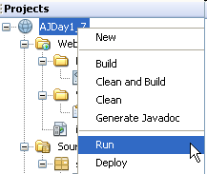
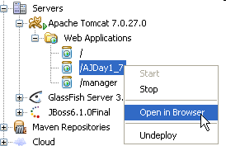
Appendix
Run Application

Slide 73

Appendix
Run Application

Slide 74


Appendix
Additional
•
Caches of server
–
WinXP: C:\Documents and Settings\LoggedUser\Application
Data\NetBeans\7.4\apache-tomcat-7.0.41.0_base\work\Catalina
\localhost\
Vista or Win7:
C:\Users\LoggedUser\AppData\Roaming\NetBeans\7.4\apache-
tomcat-7.0.41.0_base\work\Catalina\localhost\
Above location should be gone and cleared when the application
cannot be undeployed or the web servers occur the errors
–
–

Slide 75


Appendix
Create
a
Servlet
• Click Web categories
• Click the “Servlet” File Types
• Click Next button

Slide 76

Appendix
Create
a
Servlet
Fill your servlet
name
Fill or choose
package name
• Click Next button

Slide 77

Appendix
Create
a
Servlet
Modify the Servlet
Name or URL Pattern if necessary) to configure the servlet information to web.xml
• Click Finish button
• The servlet class (ex: HelloServlet.java) is added to source packages
(with package name if it’s exist) and it’s information is added to xml

Slide 78

Appendix
Create a Servlet

Slide 79

Appendix
Create a Servlet

Slide 80
The Servlet Model
ServletRequest interface
• Provides access to specific information about the request
• Defines object (ServletRequest object)
– Containing actual request (ex: protocol, URL, and type)
– Containing raw request (ex: headers and input stream)
– Containing client specific request parameters
– Is passed as an argument to the service() method
• Some methods
Methods
Descriptions
getParameter
- public String getParameter(String name)
- Returns the value of a specified parameter by the name (or null or “”)
- String strUser = request.getParameter(“txtUser”);
getParameterNames
- public Enumeration getParameterNames()
- Returns an enumeration of string objects containing the name of parameters.
- Returns an empty enumeration if the request has no parameters
- Enumeration strUser = request.getParameterName();
getParameterValues
- public String[] getParameterValues(String names)
- Returns an array of string objects containing all of the parameter
- String[] value = request.getParameterValues(”chkRemove”);
values or null if parameters do not exist.

Slide 81

Appendix – The Servlet Model
HttpServletRequest interface – Examples

Slide 82


Appendix – Servlet Model
HttpServletRequest interface – Examples

Slide 83

Appendix – The Servlet Model
HttpServletRequest interface – Examples

Slide 84

Appendix – The Servlet Model
HttpServletRequest interface – Examples

Slide 85


Appendix – The Servlet Model
HttpServletRequest interface – Examples

Slide 86

Appendix – The Servlet Model
HttpServletRequest interface – Examples

Slide 87

Appendix – The Servlet Model
HttpServletRequest interface – Examples

Slide 88

Appendix – The Servlet Model
HttpServletRequest interface – Examples

Slide 89

Appendix – The Servlet Model
HttpServletRequest interface – Examples

Slide 90


Appendix – The Servlet Model
HttpServletRequest interface – Examples

Slide 91

Appendix – The Servlet Model
HttpServletRequest interface – Examples

Slide 92

Appendix – The Servlet Model
HttpServletRequest interface – Examples

Slide 93


Appendix – The Servlet Model
HttpServletRequest interface – Examples

Slide 94


Appendix – The Servlet Model
HttpServletRequest interface – Examples

Slide 95


Appendix – The Servlet Model
HttpServletRequest interface – Examples

Slide 96
The Servlet Model
ServletResponse interface
• Is response sent by the servlet to the client
• Include all the methods needed to create and manipulate a
servlet’s output
• Retrieve an output stream to send data to the client, decide on the
content type ...
• Define objects passed as an argument to service() method
• Some methods
Methods
Descriptions
getContentType
- public String getContentType()
- Returns the Multipurpose Internet Mail Extensions (MIME)
- String contentType = response.getContentType();
type of the request body or null if the type is not known
getWriter
- public PrintWriter getWriter() throws IOException
- Returns an object of PrintWriter class that sends character
- PrintWriter out = response.getWriter();
text to the client, particular Browser.

Slide 97
The Servlet Model
ServletResponse
interface
Methods
Descriptions
getOutputStream
- public ServletOutputStream getOutputStream() throws
IOException
- Uses ServletOutputStream object to write response as binary data to the client.
- ServletOutputStream out = response.getOutputStream();
- 02 supporting methods
+ public void print(boolean b) throws IOException
. writes a boolean value to the client with no carriage return line feed (CRLF) character at the end
. out.print(b);
+ public void println(char c) throws IOException
. same as the print methods but it writes a character value
to the client, followed by a carriage return line feed (CRLF)
setContentType
- public void setContentType(String str)
- Used to set format in which the data is sent to the client, either
- Ex: response.setContentType(“text/html”);
normal text formate or html format

Slide 98
The Servlet Model
HttpServletResponse interface
• Extends ServletResponse Interface
• Defines HttpServlet objects to pass as an argument to the service() method to
the client
• Set HTTP response, HTTP header, set content type of the response, acquire a text stream for the response, acquire a binary stream for the response, redirect an HTTP request to another URL or add cookies to the response
Methods
Descriptions
encodeRedirectURL
- public String encodeRedirectURL (String url)
- Encodes the specified URL for use in the sendRedirect
unchanged
method,
or
if
encoding
is
not
needed,
returns
the
URL
sendRedirect
- public void sendRedirect(String URL) throws
IOException
- Sends a redirect response to the client using the specified redirect location URL
- the servlet using the sendRedirect method to decide the request handled by particular servlet or
- Ex: response.sendRedirect(“process.jsp”);

Slide 99

Appendix – The Servlet Model
HttpServletResponse interface - Example

Slide 100

Appendix – The Servlet Model
HttpServletResponse interface - Example
• Using sendRedirect

Slide 101

Appendix – The Servlet Model
HttpServletResponse interface - Example
• ResServlet

Slide 102
The Servlet Model
HttpServlet class
• The protocol defines a set of text-based request messages called
HTTP ‘methods’ implemented in HttpServlet class
• Provides an abstract class to create an HTTP Servlet
• Extends the GenericServlet class
• A subclass of HttpServlet class must override at least one of the
following methods: doGet(), doPost, doPut(), doDelete(), init(),
destroy(), and getServletInfo
• Some methods to process the request
Methods
Descriptions
doGet
- protected void doGet(HttpServletRequest req, HttpServletResponse res)
throws ServletException, IOException
- This method is called through service() method
- called by container to handle the GET request.
doPost
- protected void doPost(HttpServletRequest req, HttpServletResponse res)
throws ServletException, IOException
- This method is called through service() method
- called by container to handle the POST request.

Slide 103

The Servlet Model
HttpServletRequest
interface
•
Extends
ServletRequest
Interface
•
Add
a
few
for
more
handling request
methods
HTTP-specific
data
Defines
•
an
HttpServletRequest
object
passed
as
an
the
argument
to
service() method

Slide 104

Appendix – Build The Simple Web
Login Page

Slide 105

Appendix – Build The Simple Web
Invalid Page

Slide 106

Appendix – Build The Simple Web
Welcome Page

Slide 107

Appendix – Build The Simple Web
Process Servlet

Slide 108

Appendix – Build The Simple Web
DAO

Slide 109

Appendix – Build The Simple Web
DAO

Slide 110

Appendix – Build The Simple Web
Login Servlet

